Slide 1
House Prices: Advanced Regression Techniques

Slide 2
Model Analysis

Slide 3
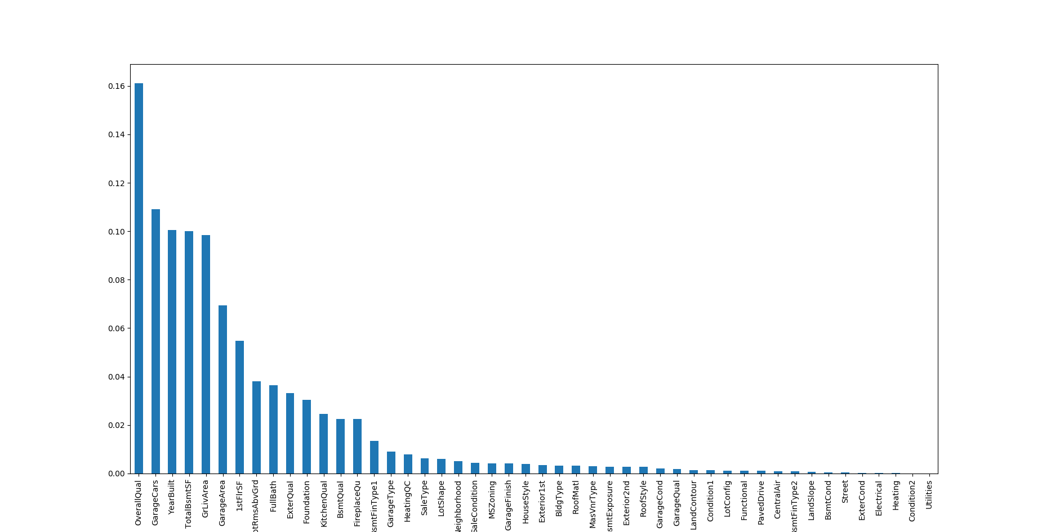
Feature Importance After Modeling

Slide 4
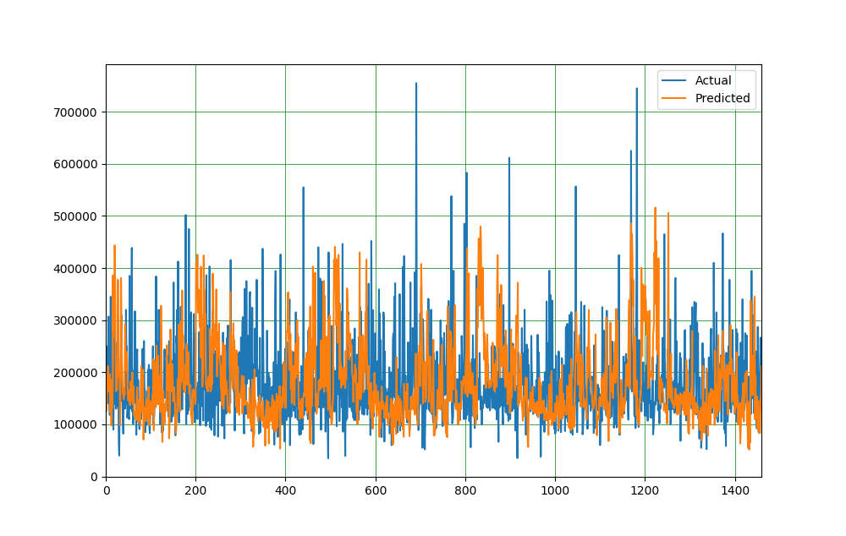
Plotting Training Data Prediction

Slide 5
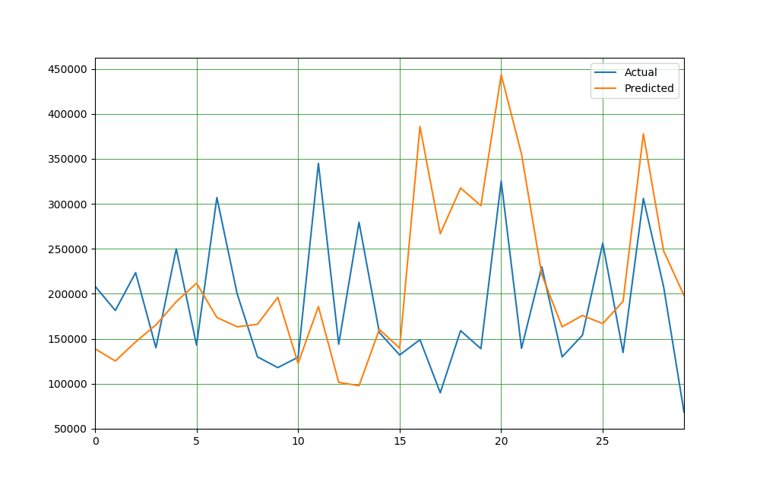

Slide 6
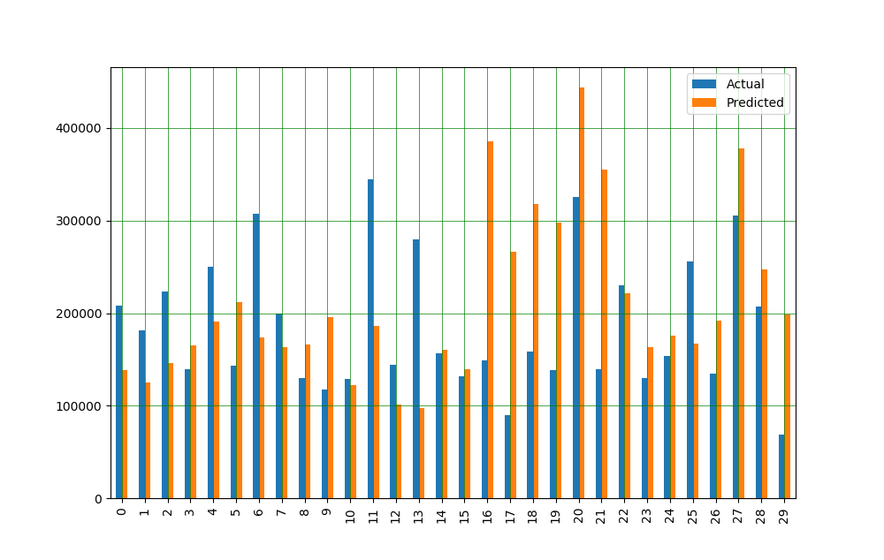

Slide 7
Thank You That's All.

